Slide 1
Chapter 8: Filing and File Structure
Overview of Physical Storage Media
Magnetic Disks
Storage Access
File Organization
Organization of Records in Files
Index
Data-Dictionary Storage

Slide 2
Classification of Physical Storage Media
Speed with which data can be accessed
Cost per unit of data
Reliability
  data loss on power failure or system crash
  physical failure of the storage device
Can differentiate storage into:
  volatile storage: loses contents when power is switched off
  non-volatile storage:
    Contents persist even when power is switched off.
    Includes secondary and tertiary storage, as well as batter-backed up main-memory.

Slide 3
Physical Storage Media
Cache – fastest and most costly form of storage; volatile; managed by the computer system hardware.
Main memory:
  fast access (10s to 100s of nanoseconds; 1 nanosecond = 10^{–9} seconds)
  generally too small (or too expensive) to store the entire database
    capacities of up to a few Gigabytes widely used currently
    Capacities have gone up and per-byte costs have decreased steadily and rapidly (roughly factor of 2 every 2 to 3 years)
  Volatile — contents of main memory are usually lost if a power failure or system crash occurs.

Slide 4
Physical Storage Media (Cont.)
Flash memory
  Data survives power failure
  Data can be written at a location only once, but location can be erased and written to again
    Can support only a limited number of write/erase cycles.
    Erasing of memory has to be done to an entire bank of memory
  Reads are roughly as fast as main memory
  But writes are slow (few microseconds), erase is slower
  Cost per unit of storage roughly similar to main memory
  Widely used in embedded devices such as digital cameras
  also known as EEPROM (Electrically Erasable Programmable Read-Only Memory)

Slide 5
Physical Storage Media (Cont.)
Magnetic-disk
  Data is stored on spinning disk, and read/written magnetically
  Primary medium for the long-term storage of data; typically stores entire database.
  Data must be moved from disk to main memory for access, and written back for storage
    Much slower access than main memory (more on this later)
  direct-access – possible to read data on disk in any order, unlike magnetic tape
  Hard disks vs floppy disks
  Capacities range up to roughly 100 GB currently
    Much larger capacity and cost/byte than main memory/flash memory
    Growing constantly and rapidly with technology improvements (factor of 2 to 3 every 2 years)
  Survives power failures and system crashes
    disk failure can destroy data, but is very rare

Slide 6
Physical Storage Media (Cont.)
Optical storage
  non-volatile, data is read optically from a spinning disk using a laser
  CD-ROM (640 MB) and DVD (4.7 to 17 GB) most popular forms
  Write-one, read-many (WORM) optical disks used for archival storage (CD-R and DVD-R)
  Multiple write versions also available (CD-RW, DVD-RW, and DVD-RAM)
  Reads and writes are slower than with magnetic disk
  Juke-box systems, with large numbers of removable disks, a few drives, and a mechanism for automatic loading/unloading of disks available for storing large volumes of data

Slide 7
Physical Storage Media (Cont.)
Tape storage
  non-volatile, used primarily for backup (to recover from disk failure), and for archival data
  sequential-access – much slower than disk
  very high capacity (40 to 300 GB tapes available)
  tape can be removed from drive ⇒ storage costs much cheaper than disk, but drives are expensive
  Tape jukeboxes available for storing massive amounts of data
    hundreds of terabytes (1 terabyte = 10⁹ bytes) to even a petabyte (1 petabyte = 10¹² bytes)

Slide 8
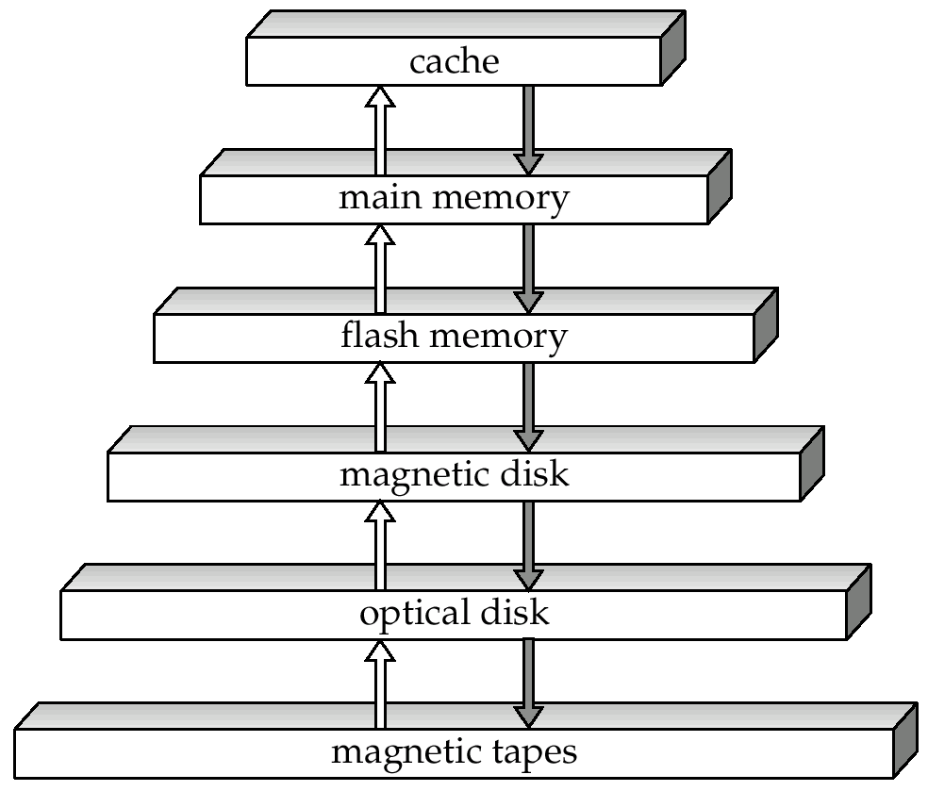
Storage Hierarchy

Slide 9
Storage Hierarchy (Cont.)
primary storage: Fastest media but volatile (cache, main memory).
secondary storage: next level in hierarchy, non-volatile, moderately fast access time
  also called on-line storage
  E.g. flash memory, magnetic disks
tertiary storage: lowest level in hierarchy, non-volatile, slow access time
  also called off-line storage
  E.g. magnetic tape, optical storage

Slide 10
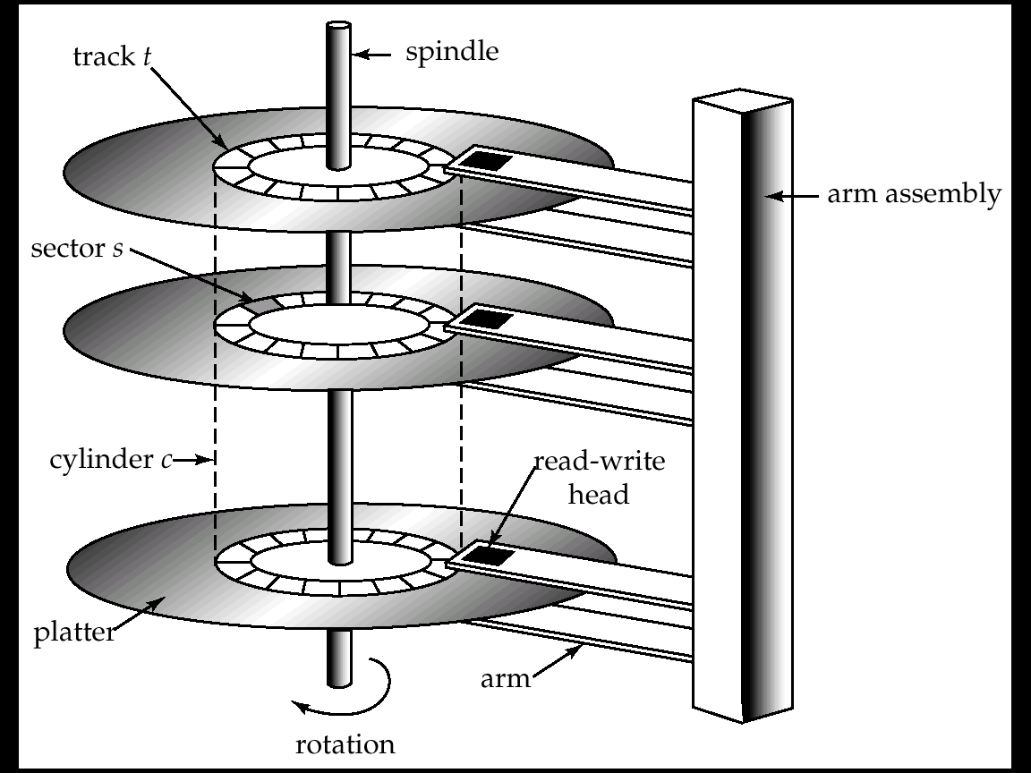
Magnetic Hard Disk Mechanism
NOTE: Diagram is schematic, and simplifies the structure of actual disk drives

Slide 11
Magnetic Disks
Read-write head
  Positioned very close to the platter surface (almost touching it)
  Reads or writes magnetically encoded information.
Surface of platter divided into circular tracks
  Over 16,000 tracks per platter on typical hard disks
Each track is divided into sectors.
  A sector is the smallest unit of data that can be read or written.
  Sector size typically 512 bytes
  Typical sectors per track: 200 (on inner tracks) to 400 (on outer tracks)
To read/write a sector
  disk arm swings to position head on right track
  platter spins continually; data is read/written as sector passes under head
Head-disk assemblies
  multiple disk platters on a single spindle (typically 2 to 4)
  one head per platter, mounted on a common arm.
Cylinder i consists of i^{th} track of all the platters

Slide 12
Magnetic Disks (Cont.)
Earlier generation disks were susceptible to head-crashes
  Surface of earlier generation disks had metal-oxide coatings which would disintegrate on head crash and damage all data on disk
  Current generation disks are less susceptible to such disastrous failures, although individual sectors may get corrupted
Disk controller – interfaces between the computer system and the disk drive hardware.
  accepts high-level commands to read or write a sector
  initiates actions such as moving the disk arm to the right track and actually reading or writing the data
  Computes and attaches checksums to each sector to verify that data is read back correctly
    If data is corrupted, with very high probability stored checksum won’t match recomputed checksum
  Ensures successful writing by reading back sector after writing it
  Performs remapping of bad sectors

Slide 13
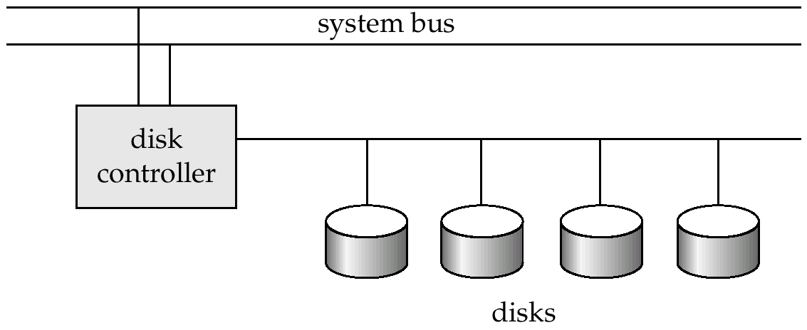
Disk Subsystem
Multiple disks connected to a computer system through a controller
  Controllers functionality (checksum, bad sector remapping) often carried out by individual disks; reduces load on controller
Disk interface standards families
  ATA (AT adaptor) range of standards
  SCSI (Small Computer System Interconnect) range of standards
  Several variants of each standard (different speeds and capabilities)

Slide 14
Performance Measures of Disks
Access time – the time it takes from when a read or write request is issued to when data transfer begins. Consists of:
  Seek time – time it takes to reposition the arm over the correct track.
    Average seek time is 1/2 the worst case seek time.
      Would be 1/3 if all tracks had the same number of sectors, and we ignore the time to start and stop arm movement
    4 to 10 milliseconds on typical disks
  Rotational latency – time it takes for the sector to be accessed to appear under the head.
    Average latency is 1/2 of the worst case latency.
    4 to 11 milliseconds on typical disks (5400 to 15000 r.p.m.)
Data-transfer rate – the rate at which data can be retrieved from or stored to the disk.
  4 to 8 MB per second is typical
  Multiple disks may share a controller, so rate that controller can handle is also important
    E.g. ATA-5: 66 MB/second, SCSI-3: 40 MB/s
    Fiber Channel: 256 MB/s

Slide 15
Performance Measures (Cont.)
Mean time to failure (MTTF) – the average time the disk is expected to run continuously without any failure.
  Typically 3 to 5 years
  Probability of failure of new disks is quite low, corresponding to a
  “theoretical MTTF” of 30,000 to 1,200,000 hours for a new disk
    E.g., an MTTF of 1,200,000 hours for a new disk means that given 1000 relatively new disks, on an average one will fail every 1200 hours
  MTTF decreases as disk ages

Slide 16
Optimization of Disk-Block Access
Block – a contiguous sequence of sectors from a single track
  data is transferred between disk and main memory in blocks
  sizes range from 512 bytes to several kilobytes
    Smaller blocks: more transfers from disk
    Larger blocks: more space wasted due to partially filled blocks
    Typical block sizes today range from 4 to 16 kilobytes
Disk-arm-scheduling algorithms order pending accesses to tracks so that disk arm movement is minimized
  elevator algorithm : move disk arm in one direction (from outer to inner tracks or vice versa), processing next request in that direction, till no more requests in that direction, then reverse direction and repeat

Slide 17
Optimization of Disk Block Access (Cont.)
File organization – optimize block access time by organizing the blocks to correspond to how data will be accessed
  E.g. Store related information on the same or nearby cylinders.
  Files may get fragmented over time
    E.g. if data is inserted to/deleted from the file
    Or free blocks on disk are scattered, and newly created file has its blocks scattered over the disk
    Sequential access to a fragmented file results in increased disk arm movement
  Some systems have utilities to defragment the file system, in order to speed up file access

Slide 18
Optimization of Disk Block Access (Cont.)
Nonvolatile write buffers speed up disk writes by writing blocks to a non-volatile RAM buffer immediately
  Non-volatile RAM: battery backed up RAM or flash memory
    Even if power fails, the data is safe and will be written to disk when power returns
  Controller then writes to disk whenever the disk has no other requests or request has been pending for some time
  Database operations that require data to be safely stored before continuing can continue without waiting for data to be written to disk
  Writes can be reordered to minimize disk arm movement
Log disk – a disk devoted to writing a sequential log of block updates
  Used exactly like nonvolatile RAM
    Write to log disk is very fast since no seeks are required
    No need for special hardware (NV-RAM)
File systems typically reorder writes to disk to improve performance
  Journaling file systems write data in safe order to NV-RAM or log disk
  Reordering without journaling: risk of corruption of file system data

Slide 19
Storage Access
A database file is partitioned into fixed-length storage units called blocks. Blocks are units of both storage allocation and data transfer.
Database system seeks to minimize the number of block transfers between the disk and memory. We can reduce the number of disk accesses by keeping as many blocks as possible in main memory.
Buffer – portion of main memory available to store copies of disk blocks.
Buffer manager – subsystem responsible for allocating buffer space in main memory.

Slide 20
Buffer Manager
Programs call on the buffer manager when they need a block from disk.
  If the block is already in the buffer, the requesting program is given the address of the block in main memory
  If the block is not in the buffer,
    the buffer manager allocates space in the buffer for the block, replacing (throwing out) some other block, if required, to make space for the new block.
    The block that is thrown out is written back to disk only if it was modified since the most recent time that it was written to/fetched from the disk.
    Once space is allocated in the buffer, the buffer manager reads the block from the disk to the buffer, and passes the address of the block in main memory to requester.

Slide 21
File Organization
The database is stored as a collection of files. Each file is a sequence of records. A record is a sequence of fields.
One approach:
  assume record size is fixed
  each file has records of one particular type only
  different files are used for different relations
  This case is easiest to implement; will consider variable length records
  later.

Slide 22
Organization of Records in Files
Heap – a record can be placed anywhere in the file where there is space
Sequential – store records in sequential order, based on the value of the search key of each record
Hashing – a hash function computed on some attribute of each record; the result specifies in which block of the file the record should be placed
Records of each relation may be stored in a separate file. In a clustering file organization records of several different relations can be stored in the same file
  Motivation: store related records on the same block to minimize I/O

Slide 23
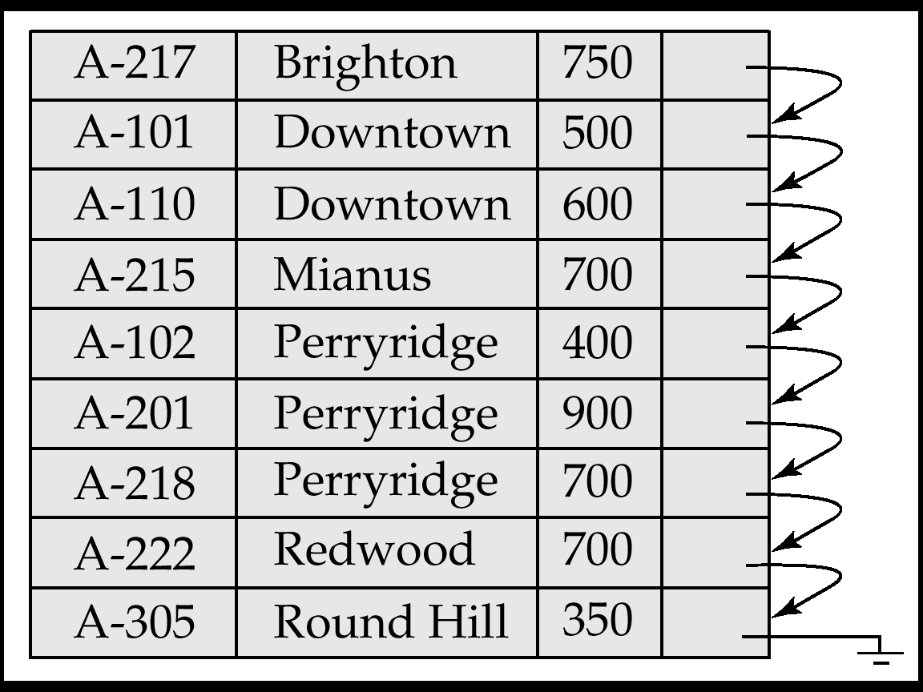
Sequential File Organization
Suitable for applications that require sequential processing of the entire file
The records in the file are ordered by a search-key

Slide 24
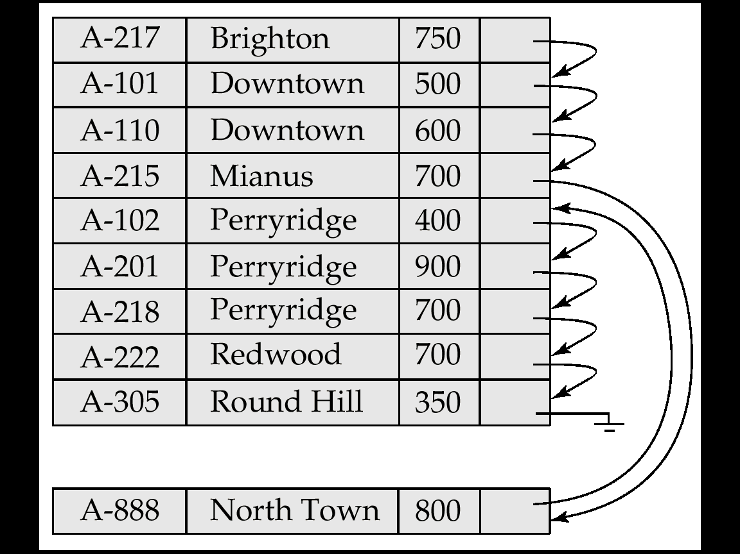
Sequential File Organization (Cont.)
Deletion – use pointer chains
Insertion –locate the position where the record is to be inserted
  if there is free space insert there
  if no free space, insert the record in an overflow block
  In either case, pointer chain must be updated
Need to reorganize the file
from time to time to restore
sequential order

Slide 25
Basic Concepts of Indexing
Indexing mechanisms used to speed up access to desired data.
  E.g., author catalog in library
Search Key - attribute to set of attributes used to look up records in a file.
An index file consists of records (called index entries) of the form
Index files are typically much smaller than the original file
Two basic kinds of indices:
  Ordered indices: search keys are stored in sorted order
  Hash indices: search keys are distributed uniformly across “buckets” using a “hash function”.
search-key
pointer

Slide 26
Index Evaluation Metrics
Access types supported efficiently. E.g.,
  records with a specified value in the attribute
  or records with an attribute value falling in a specified range of values.
Access time
Insertion time
Deletion time
Space overhead

Slide 27
Ordered Indices
Indexing techniques evaluated on basis of:
In an ordered index, index entries are stored sorted on the search key value. E.g., author catalog in library.
Primary index: in a sequentially ordered file, the index whose search key specifies the sequential order of the file.
  Also called clustering index
  The search key of a primary index is usually but not necessarily the primary key.
Secondary index: an index whose search key specifies an order different from the sequential order of the file. Also called
non-clustering index.
Index-sequential file: ordered sequential file with a primary index.

Slide 28
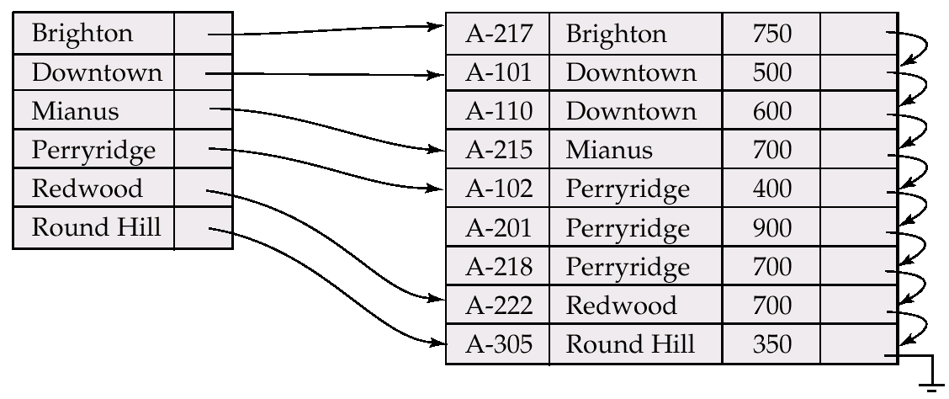
Dense Index Files
Dense index — Index record appears for every search-key value in the file.

Slide 29
Sparse Index Files
Sparse Index: contains index records for only some search-key values.
  Applicable when records are sequentially ordered on search-key
To locate a record with search-key value K we:
  Find index record with largest search-key value < K
  Search file sequentially starting at the record to which the index record points
Less space and less maintenance overhead for insertions and deletions.
Generally slower than dense index for locating records.
Good tradeoff: sparse index with an index entry for every block in file, corresponding to least search-key value in the block.

Slide 30
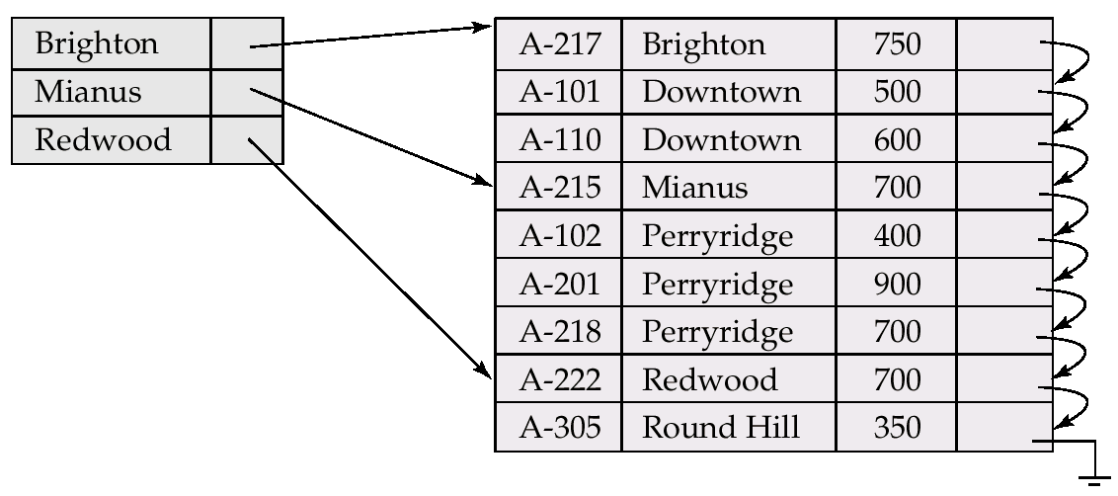
Example of Sparse Index Files

Slide 31
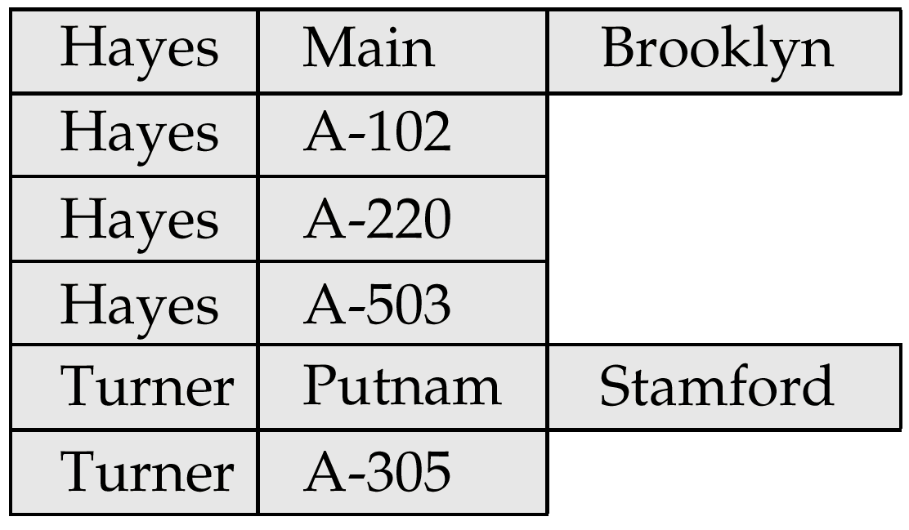
Clustering File Organization
Simple file structure stores each relation in a separate file
Can instead store several relations in one file using a clustering file organization
E.g., clustering organization of customer and depositor:
  good for queries involving depositor customer, and for queries involving one single customer and his accounts
  bad for queries involving only customer
  results in variable size records

Slide 32
Secondary Indices
Frequently, one wants to find all the records whose values in a certain field (which is not the search-key of the primary index satisfy some condition.
  Example 1: In the account database stored sequentially by account number, we may want to find all accounts in a particular branch
  Example 2: as above, but where we want to find all accounts with a specified balance or range of balances
We can have a secondary index with an index record for each search-key value; index record points to a bucket that contains pointers to all the actual records with that particular search-key value.

Slide 33
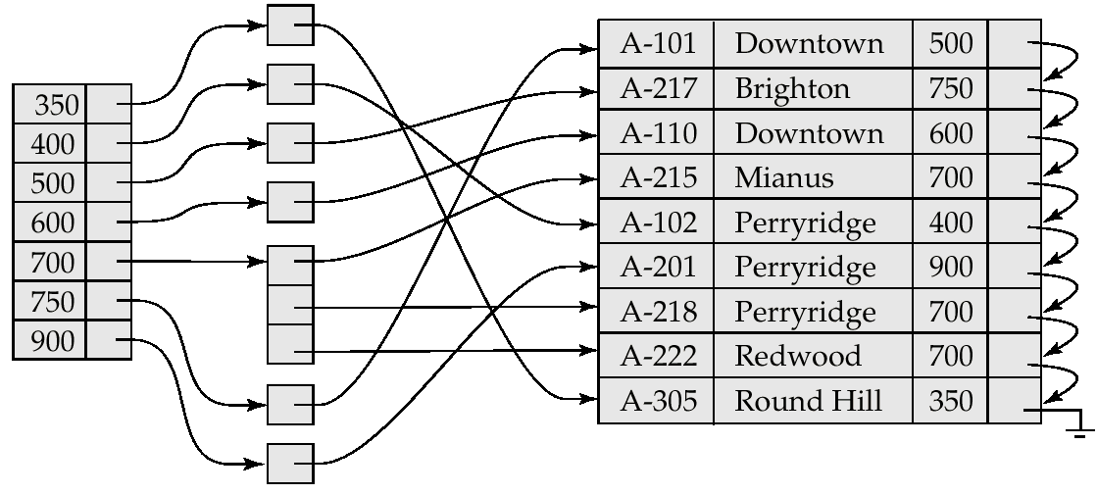
Secondary Index on balance field of account

Slide 34
Primary and Secondary Indices
Secondary indices have to be dense.
Indices offer substantial benefits when searching for records.
When a file is modified, every index on the file must be updated, Updating indices imposes overhead on database modification.
Sequential scan using primary index is efficient, but a sequential scan using a secondary index is expensive
  each record access may fetch a new block from disk

Slide 35
B⁺-Tree Index Files
B⁺-tree indices are an alternative to indexed-sequential files.
Disadvantage of indexed-sequential files: performance degrades as file grows, since many overflow blocks get created. Periodic reorganization of entire file is required.
Advantage of B⁺-tree index files: automatically reorganizes itself with small, local, changes, in the face of insertions and deletions. Reorganization of entire file is not required to maintain performance.
Disadvantage of B⁺-trees: extra insertion and deletion overhead, space overhead.
Advantages of B⁺-trees outweigh disadvantages, and they are used extensively.

Slide 36
B⁺-Tree Index Files (Cont.)
A B⁺-tree is a rooted tree satisfying the following properties:
All paths from root to leaf are of the same length
Each node that is not a root or a leaf has between [n/2] and n children.
A leaf node has between [(n–1)/2] and n–1 values
Special cases:
  If the root is not a leaf, it has at least 2 children.
  If the root is a leaf (that is, there are no other nodes in the tree), it can have between 0 and (n–1) values.

Slide 37

Example of a B⁺-tree
B⁺-tree for account file (n = 3)

Slide 38
Static Hashing
A bucket is a unit of storage containing one or more records (a bucket is typically a disk block).
In a hash file organization we obtain the bucket of a record directly from its search-key value using a hash function.
Hash function h is a function from the set of all search-key values K to the set of all bucket addresses B.
Hash function is used to locate records for access, insertion as well as deletion.
Records with different search-key values may be mapped to the same bucket; thus entire bucket has to be searched sequentially to locate a record.

Slide 39
Example of Hash File Organization (Cont.)
Hash file organization of account file, using branch-name as key
(See figure in next slide.)
There are 10 buckets,
The binary representation of the ith character is assumed to be the integer i.
The hash function returns the sum of the binary representations of the characters modulo 10
  E.g. h(Perryridge) = 5 h(Round Hill) = 3 h(Brighton) = 3

Slide 40
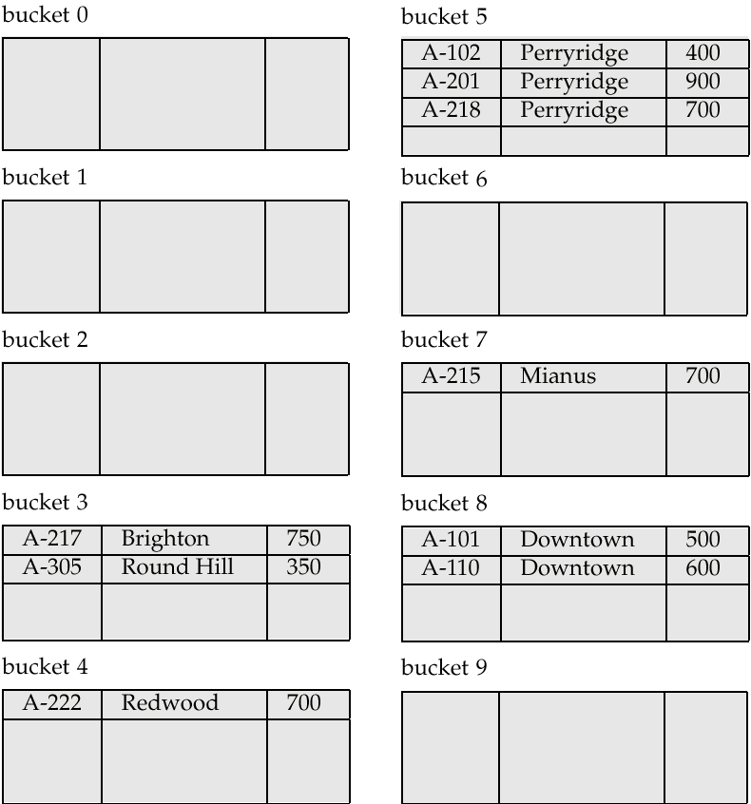
Example of Hash File Organization
Hash file organization of account file, using branch-name as key

Slide 41
Hash Functions
Worst has function maps all search-key values to the same bucket; this makes access time proportional to the number of search-key values in the file.
An ideal hash function is uniform, i.e., each bucket is assigned the same number of search-key values from the set of all possible values.
Ideal hash function is random, so each bucket will have the same number of records assigned to it irrespective of the actual distribution of search-key values in the file.
Typical hash functions perform computation on the internal binary representation of the search-key.
  For example, for a string search-key, the binary representations of all the characters in the string could be added and the sum modulo the number of buckets could be returned. .

Slide 42
Handling of Bucket Overflows
Bucket overflow can occur because of
  Insufficient buckets
  Skew in distribution of records. This can occur due to two reasons:
    multiple records have same search-key value
    chosen hash function produces non-uniform distribution of key values
Although the probability of bucket overflow can be reduced, it cannot be eliminated; it is handled by using overflow buckets.

Slide 43
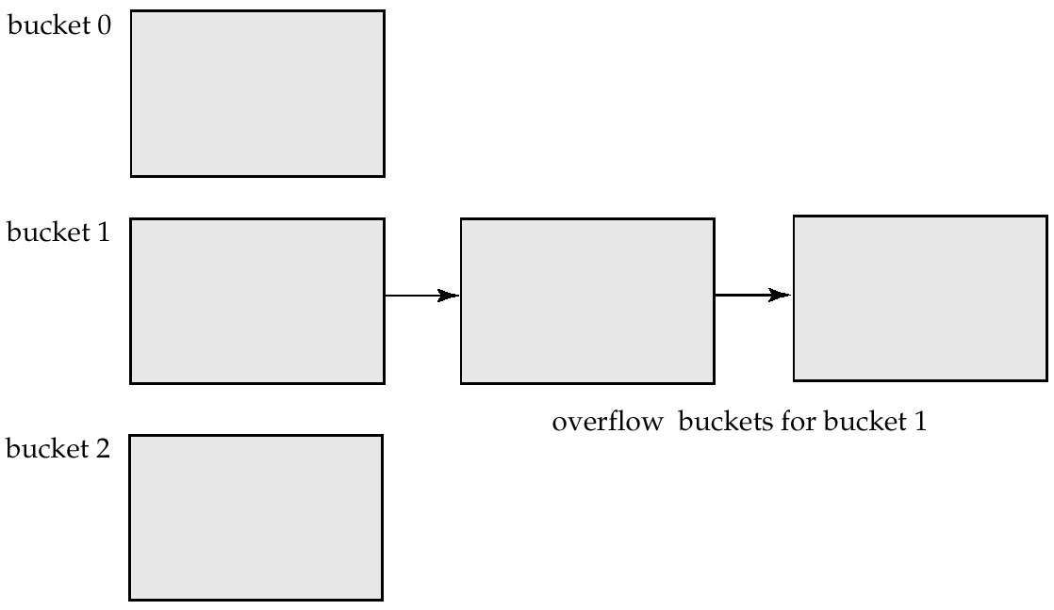
Handling of Bucket Overflows (Cont.)
Overflow chaining – the overflow buckets of a given bucket are chained together in a linked list.
Above scheme is called closed hashing.
  An alternative, called open hashing, which does not use overflow buckets, is not suitable for database applications.

Slide 44
Hash Indices
Hashing can be used not only for file organization, but also for index-structure creation.
A hash index organizes the search keys, with their associated record pointers, into a hash file structure.
Strictly speaking, hash indices are always secondary indices
  if the file itself is organized using hashing, a separate primary hash index on it using the same search-key is unnecessary.
  However, we use the term hash index to refer to both secondary index structures and hash organized files.

Slide 45
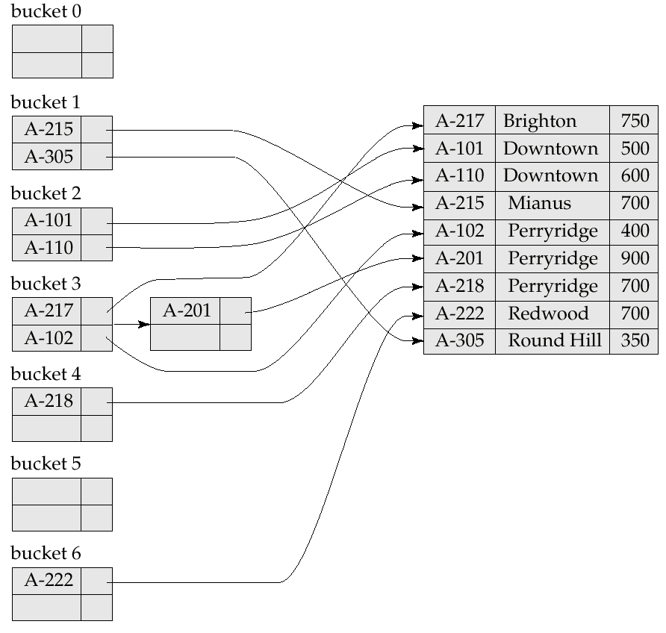
Example of Hash Index

Slide 46
Deficiencies of Static Hashing
In static hashing, function h maps search-key values to a fixed set of B of bucket addresses.
  Databases grow with time. If initial number of buckets is too small, performance will degrade due to too much overflows.
  If file size at some point in the future is anticipated and number of buckets allocated accordingly, significant amount of space will be wasted initially.
  If database shrinks, again space will be wasted.
  One option is periodic re-organization of the file with a new hash function, but it is very expensive.
These problems can be avoided by using techniques that allow the number of buckets to be modified dynamically.

Slide 47
Dynamic Hashing
Good for database that grows and shrinks in size
Allows the hash function to be modified dynamically
Extendable hashing – one form of dynamic hashing
  Hash function generates values over a large range — typically b-bit integers, with b = 32.
  At any time use only a prefix of the hash function to index into a table of bucket addresses.
  Let the length of the prefix be i bits, 0 ≤ i ≤ 32.
  Bucket address table size = 2^{i.} Initially i = 0
  Value of i grows and shrinks as the size of the database grows and shrinks.
  Multiple entries in the bucket address table may point to a bucket.
  Thus, actual number of buckets is < 2^{i}
    The number of buckets also changes dynamically due to coalescing and splitting of buckets.

Slide 48
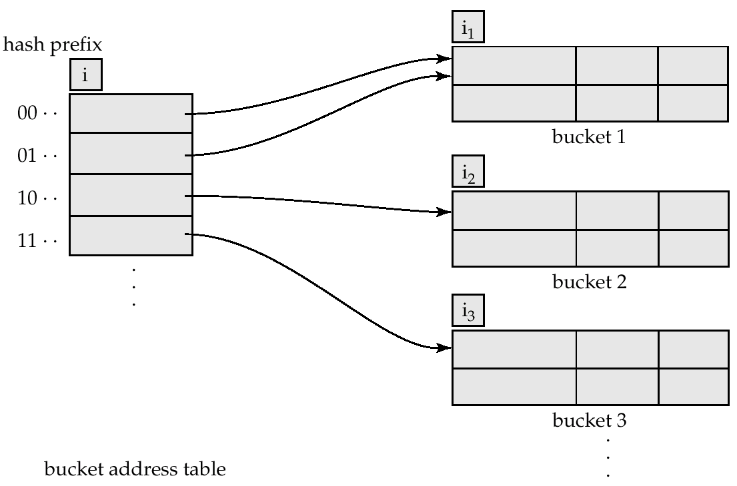
General Extendable Hash Structure
In this structure, i₂ = i₃ = i, whereas i₁ = i – 1 (see next slide for details)

Slide 49
Use of Extendable Hash Structure
Each bucket j stores a value i_{j}; all the entries that point to the same bucket have the same values on the first i_{j} bits.
To locate the bucket containing search-key K_{j}:
  1. Compute h(K_{j}) = X
  2. Use the first i high order bits of X as a displacement into bucket address table, and follow the pointer to appropriate bucket
To insert a record with search-key value K_{j}
  follow same procedure as look-up and locate the bucket, say j.
  If there is room in the bucket j insert record in the bucket.
  Else the bucket must be split and insertion re-attempted (next slide.)
    Overflow buckets used instead in some cases (will see shortly)

Slide 50
Comparison of Ordered Indexing and Hashing
Cost of periodic re-organization
Relative frequency of insertions and deletions
Is it desirable to optimize average access time at the expense of worst-case access time?
Expected type of queries:
  Hashing is generally better at retrieving records having a specified value of the key.
  If range queries are common, ordered indices are to be preferred

Slide 51
Data Dictionary Storage
Data dictionary (also called system catalog) stores metadata: that is, data about data, such as
Information about relations
  names of relations
  names and types of attributes of each relation
  names and definitions of views
  integrity constraints
User and accounting information, including passwords
Statistical and descriptive data
  number of tuples in each relation
Physical file organization information
  How relation is stored (sequential/hash/…)
  Physical location of relation
    operating system file name or
    disk addresses of blocks containing records of the relation
Information about indices (Chapter 12)

Slide 52
Data Dictionary Storage (Cont.)
Catalog structure: can use either
  specialized data structures designed for efficient access
  a set of relations, with existing system features used to ensure efficient access
  The latter alternative is usually preferred
A possible catalog representation:
Relation-metadata = (relation-name, number-of-attributes,
storage-organization, location)
Attribute-metadata = (attribute-name, relation-name, domain-type,
position, length)
User-metadata = (user-name, encrypted-password, group)
Index-metadata = (index-name, relation-name, index-type,
index-attributes)
View-metadata = (view-name, definition)

